Slide 1
Developing the Whole Student: Contributions of
Service Learning
William Huitt
Christine Ratzke de Figueiredo

Slide 2
Topic Outline
Necessity for framework for holistic development
Overview of 9 domains included in Brilliant Star framework
Applications in service learning and CAS projects
Next steps

Slide 3
Framework Needed
To assist in curriculum articulation and analysis
Two primary alternatives
  Traditional
    Specific academic knowledge
    Critical thinking
  Holistic
    Conceptual, integrated academic knowledge
    Processes of thinking
    Emotional and Social Development
    Moral Character

Slide 4
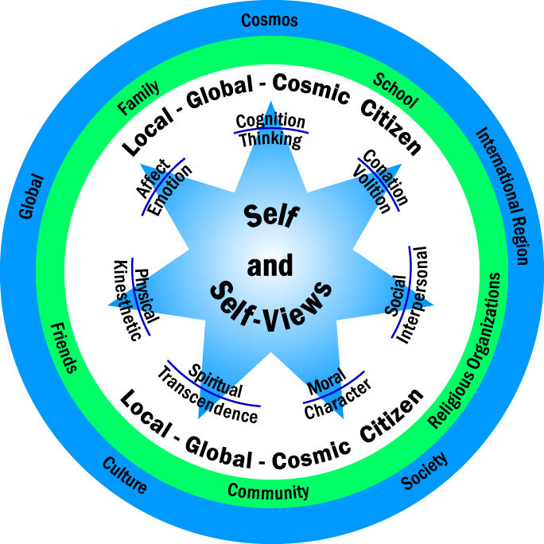

Slide 5
Becoming a Brilliant Star
Defined domains of capacities and virtues/strengths
Started with Gardner’s work on Multiple Intelligences
Investigated what others had labeled as intelligences

Slide 6
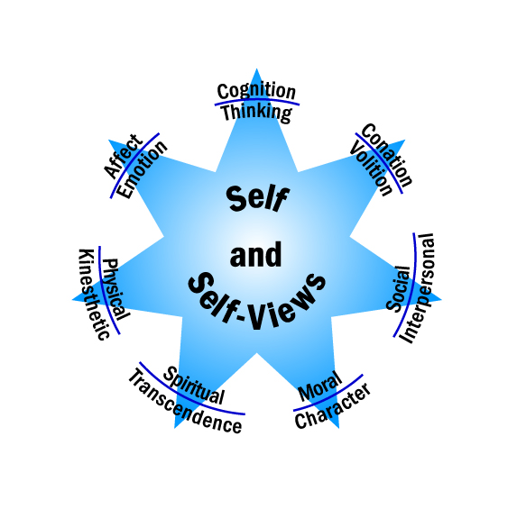

Slide 7
The Nine Domains
Self and Conscious Construction of Self-Views
  Self
    Temperament/Personality
    Personal interests
    Self-views
      Self-concept
      Self-esteem
      Self-efficacy
    Well-being

Slide 8
The Nine Domains
Cognitive/Thinking Intelligence
  Often equated to IQ and academic achievement
  Think like a(n)
    Artist
    Craftsman
    Historian
    Philosopher
    Mathematician
    Scientist
    Writer/Story Teller
    Integral

Slide 9
The Nine Domains
Cognitive/Thinking Intelligence
  Often equated to IQ and academic achievement
  Cognitive Processes
    Association
    Conservation
    Analysis
    Implication
    Correlation & Causation
    Synthesis
    Evaluation
    Closure

Slide 10
The Nine Domains
Emotional/Affective Intelligence
  Capacity to deal with one’s feelings and emotions
  Capacities/Competencies
    Awareness – of one’s own emotions and emotions of others
    Connecting –empathically with others
    Expression – Differentiate subjective feelings and external expressional expression
    Self-management and self-regulation – Hype up or dampen down

Slide 11
The Nine Domains
Conative/Volitional Intelligence
  Addresses issue of personal agency
  Capacities/Competencies
    Intentionality—the ability to originate a purposeful action
    Forethought—the ability to think about the future and to make plans
    Self-reactiveness—the ability to monitor one’s actions and make corrections to achieve one’s goals
    Self-reflection—the ability to evaluate one’s purpose, values, and goals with respect to one’s plans and actions

Slide 12
The Nine Domains
Physical/Kinesthetic Intelligence
  Ability to be aware of one’s body in space and motion
  Dimensions
    Gross vs fine motor
    Basic vs advanced
  Basic physical competence
    Cardiovascular endurance
    Muscular strength
    Muscular endurance
    Flexibility

Slide 13
The Nine Domains
Social/Interpersonal Intelligence
  Ability to deal with other people and relationships
  Social Awareness
    Primal empathy
    Attunement
    Empathetic accuracy
    Social cognition
  Social Facility
    Synchrony
    Self-preservation
    Influence
    Concern

Slide 14
The Nine Domains
Spiritual/Transpersonal Intelligence
  the ability to generate meaning and purpose for one’s life
  ability to create deep, personal relationships with one’s self, with others, with nature, and universal unknowns
  Kessler
    Yearning for Deep Connection
    Longing for Silence & Solitude
    Search for Meaning & Purpose
    Hunger for Joy & Delight
    Creative Drive
    Urge of Transcendence
    Need for Initiation

Slide 15
The Nine Domains
Moral/Character Intelligence
  Ability to develop habits and patterns of thought, emotions, intentions, and behavior associated with issues of right and wrong, especially in a social context
  Narvaez and associates
    Ethical sensitivity
    Ethical judgment
    Ethical motivation
    Ethical action

Slide 16
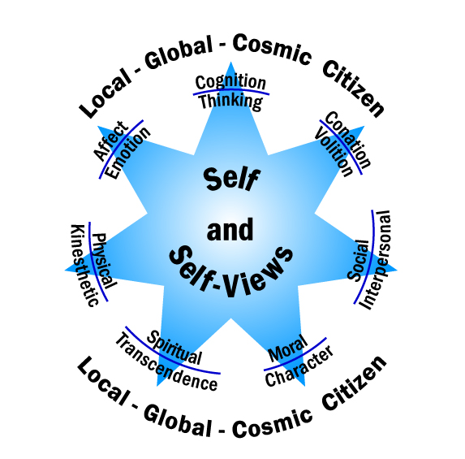

Slide 17
The Nine Domains
Local-Global-Cosmic Citizenship
  Identity with and loyalty to a sociocultural organization
    Family
    Tribe
    City state
    Empire
    Nation
    Region
    Planet
    Cosmos
      Capacities
      Sociocultural Awareness
      Value social structure
      Adult roles
      Active involvement

Slide 18
Comparison of Framework Domains and Virtues, Strengths, & Habits
Framework of capacities
Examples of virtues
  IB
  IPC
Examples of specific capacities
  Habits of Mind
  Integrated Ethics Education
  Search Institute’s Internal Assets
  Partnership for 21st Century Skills

Slide 19
Curriculum Integration
IB LEARNER PROFILE
Self/Self-views
  BALANCED
  REFLECTIVE
Cognition/Thinking
  KNOWLEDGABLE
  THINKERS
  Emotion/Affect
  CARING
Conation/Volition
INQUIRERS
RISK-TAKERS
Physical/ Kinesthetic
Spirituality/Purpose
Social/Interpersonal
COMMUNICATORS
Moral Character
PRINCIPLED
Citizenship
OPEN-MINDED

Slide 20
Curriculum Integration
IB LEARNER PROFILE
Adjusted
Self/Self-views
  BALANCED
  REFLECTIVE
  Engagement & Flow
Cognition/Thinking
  KNOWLEDGABLE
  THINKERS
  Emotion/Affect
  Emotionally developed
  Develops optimism
  Develops gratitude
  CARING
Conation/Volition
INQUIRERS
RISK-TAKERS
Resilient
Physical/ Kinesthetic
  Healthy lifestyle
  Kinesthetic competence
Spirituality/Purpose
  Meaning & Purpose
  Deep, personal relationships
Social/Interpersonal
COMMUNICATORS
Interpersonally skilled
Moral Character
Ethical sensitivity
Ethical judgment
Ethical motivation
Ethical action
Citizenship
  Sociocultural awareness (OPEN-MINDED)
  Value social structures
  Adult roles
  Actively involved

Slide 21
Virtues, Strengths, Habits
Patterns of actualized capacities
  Thinkers and/or Thoughtfulness
    Habits of Mind
      Gather data through the senses
      Think and communicate with clarity and precision
      Strive for accuracy
      Thinking flexibly
      Create, imagine, innovate
      Question and pose problems

Slide 22
Service Learning & CAS
Elementary
Middle School
Upper School

Slide 23
Curriculum Mapping and Assessment
Need to
  Specifically place holistic objectives in curriculum mapping and assessment activities
  Code service learning and CAS projects
  Analyze projects
  Make adjustments

Slide 24
References
Costa, A. L., & Kallick, B. (2000). Habits of mind: A developmental series. Alexandria, VA: Association for Supervision and Curriculum Development.
Gardner, H. (1999). Intelligence reframed: Multiple intelligences for the 21st century. New York: Basic Books.
Huitt, W. (2011, July). A holistic view of education and schooling: Guiding students to develop capacities, acquire virtues, and provide service. Revision of paper presented at the 12th Annual International Conference sponsored by the Athens Institute for Education and Research (ATINER), May 24-27, Athens, Greece. Retrieved from http://www.edpsycinteractive.org/papers/holistic-view-of-schooling-rev.pdf
International Baccalaruate Organization. (2006). IB learner profile booklet. Cardiff, Wales, UK: Author. Retrieved from http://www.ibo.org/programmes/documents/learner_profile_en.pdf
Narvaez, D. (2006). Integrative ethical education. In M. Killen & J. Smetana (Eds.), Handbook of moral development (pp. 703-733). Mahwah, NJ: Erlbaum. Retrieved from http://www.nd.edu/~dnarvaez/Narvaez%20HMD%2009.14.pdf
Partnership for 21st Century Skills. (2009). P21 framework definitions. Washington, DC: Author. Retrieved from http://www.p21.org/documents/P21_Framework_Definitions.pdf
Search Institute. (2011). Developmental assets lists. Minneapolis, MN: Author. Retrieved from http://www.search-institute.org/developmental-assets/lists

Slide 25
http://www.edpsycinteractive.org/brilstar/ecis-2011.html
http://brilliantstar.rubiconatlas.org/c/pi/v.php/Atlas/Authentication/View/Login?lrr=2&

