Slide 1
Curriculum for Global Citizenship
William G. Huitt, PhD
Walden University
Educational Psychology Interactive

Slide 2
Curriculum for Global Citizenship
Curriculum is where ideals meet reality
Four issues
  What is curriculum?
  What is the importance of global citizenship?
  What should be the focus of curriculum?
  How to deal with issue of “too much”?

Slide 3
Curriculum
Traditional definitions
  A course of study in one subject at a school or college.
  A list of all the courses of study offered by a school or college.
  Any program of planned activities.
      Collins English Dictionary (2009)

Slide 4
Curriculum
Traditional definitions
  The aggregate of courses of study given in a school, college, etc.
  The regular or a particular course of study in a school, college, etc.
      Dictionary.com (2012)

Slide 5
Curriculum
Traditional definitions
  The courses offered by an educational institution.
  A set of courses constituting an area of specialization.
      Merriam-Webster (2012)

Slide 6
Curriculum
Widespread agreement
  Children and youth need preparation
  World is changing rapidly
Less agreement
  What should be done
Focus on courses
  Centers the discussion at that level
Need to focus on
  Developing knowledge, attitudes, and skills necessary for adult success

Slide 7
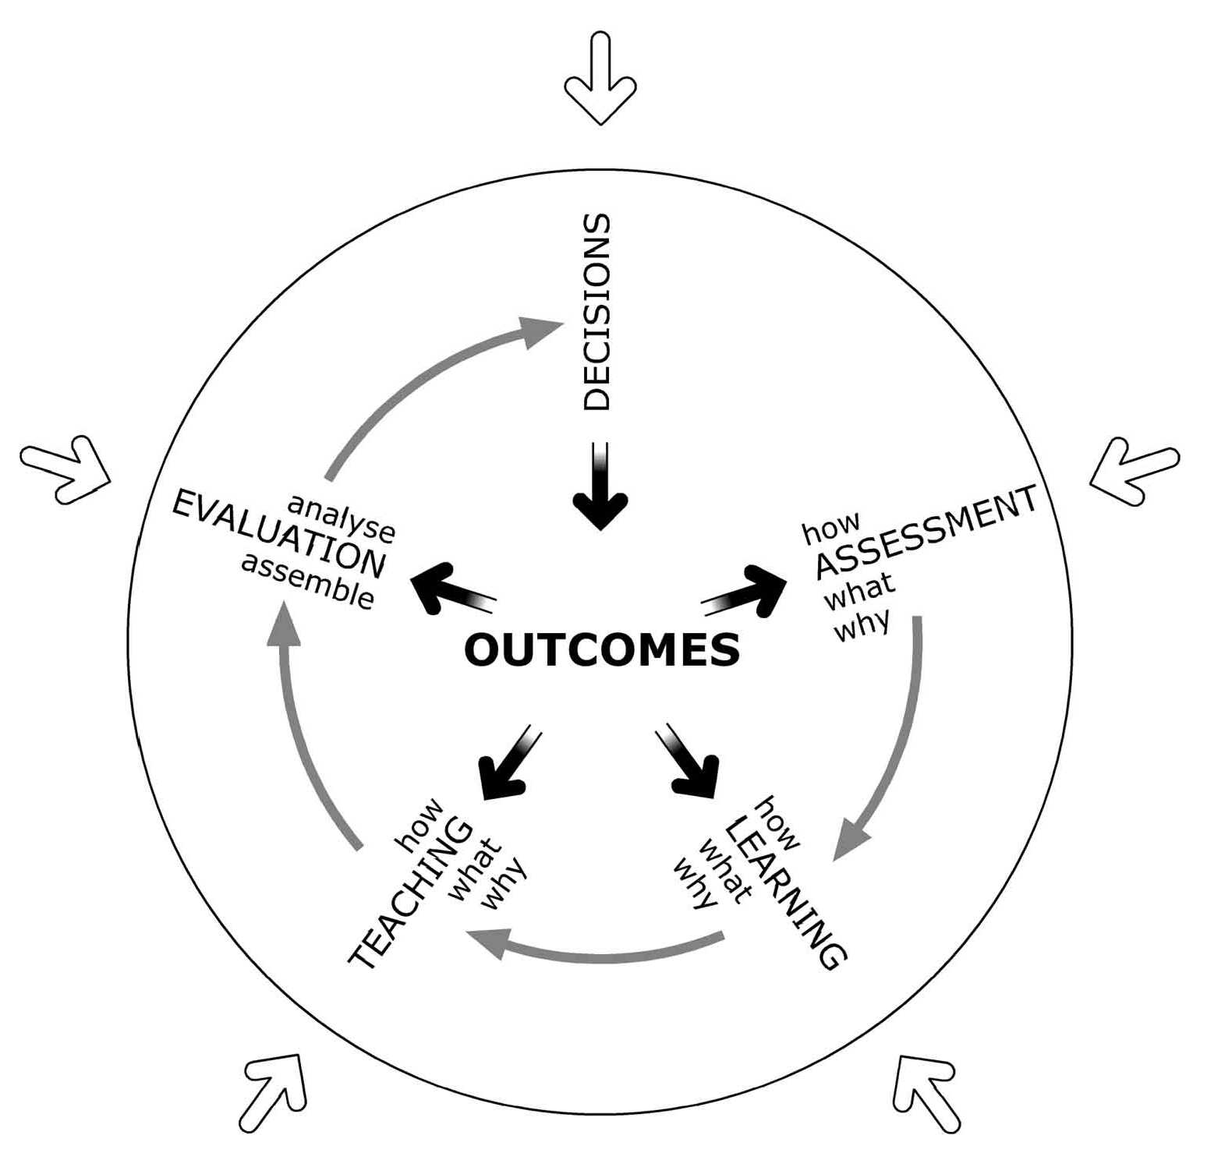
Curriculum
Stefani, 2004-05 ; modified from Cowan & Harding, 1986

Slide 8
Human Sociocultural Ages
Hunter/Gatherer
Agricultural
Industrial
Digital/Information/ Conceptual
You Are Here
1600 1800 2000 2200 2400

Slide 9
Global Citizenship
Citizenship relatively recent concept
  Beginning with Agricultural Age
Cosmopolitan citizenship
  Ancient Greeks
  Islamic world
  Renaissance Europe and Age of Enlightenment – Industrial Age
  20th century – Digital/Information/Conceptual Age

Slide 10
Global Citizenship
Age of Transition
Concept of citizenship in flux
You Are Here
1600 1800 2000 2200 2400

Slide 11
Global Citizenship
Citizenship
  Identity
  Loyalty & Responsibility
  Rights

Slide 12
Global Citizenship
Identity
  Where were you born?
  Where were your parents born?
  Where are you from?
  Where do you live?
Your answers impact your identity
Your answers depend on context

Slide 13
Global Citizenship
Loyalty and Responsibility
    Community
    State/Region
    Nation
    International Region
    Global
    Cosmic

Slide 14
Global Citizenship
Rights
  United Nations Universal Declaration of Human Rights
  Recent review of national constitutions reveals relatively small list of rights specifically mentioned

Slide 15
Global Citizenship
Most of human history
  Adapt to relatively hostile environment
20th century
  Adapt to fast-changing, relatively less hostile environment
21st century
  Create environment to which great-grandchildren will adapt

Slide 16
Global Citizenship
Imagine an ideal
Move progressively towards that ideal
You Are Here
1600 1800 2000 2200 2400

Slide 17
Curriculum Focus
Three primary starting points
  Focus on individual capacities

Slide 18
Curriculum Focus
Focus on individual capacities
  IB
    Learner Profile
  Gardner
    Multiple intelligences
  Costa and Kallick
    Habits of mind

Slide 19
Curriculum Focus
Focus on individual capacities
  Narvaez and colleagues (Kohlberg)
    Ethical sensitivity, judgment, motivation, and action
  Search Institute
    Internal assets
  Huitt
    Brilliant Star framework
http://www.edpsycinteractive.org/brilstar/CurrMap/index.html#holistic

Slide 20
Curriculum Focus
Three primary starting points
  Focus on individual capacities
  Needs, motives, and well-being

Slide 21
Curriculum Focus
Focus on needs, motives, and well-being
  Maslow
    Hierarchy of needs (Self, Other, Growth)
  Pink
    Attributes of motivation (Autonomy, Mastery, Purpose)
  Diener & Biswas-Diener
    Happiness and well-being
  Seligman
    Flourishing and well-being
http://www.edpsycinteractive.org/brilstar/CurrMap/index.html#domains

Slide 22
Curriculum Focus
Three primary starting points
  Focus on individual capacities
  Needs, motives, and well-being
  Adapt to demands of citizenship in current environment

Slide 23
Curriculum Focus
Focus on 21st century
  Partnership for 21st Century
    Core Subjects & 21st Century Themes
    Life & Career Skills
    Learning and Innovation Skills
    Information, Media, and Technology Skills
  Tony Wagner
    7 survival skills
    Knowledge, attitudes, and skills required for innovation
http://www.edpsycinteractive.org/brilstar/CurrMap/index.html#21st

Slide 24
Curriculum Focus
Three primary starting points
  Focus on individual capacities
  Needs, motives, and well-being
  Adapt to demands of citizenship in current environment
All
  Develop human capacities so that needs are met within a rapidly changing sociocultural context
http://www.edpsycinteractive.org/brilstar/CurrMap/ltr/comparison-of-frameworks.xlsx

Slide 25
Curriculum Focus
Practical implementation
  Requires analysis among competing alternatives
Must integrate across frameworks
Curriculum Mapping Project
http://www.edpsycinteractive.org/brilstar/CurrMap/index.html

Slide 26
Too Much
Outcome of analysis
  Too many desired outcomes
Legitimate reasons for making different decisions

Slide 27
Too Much
People take different roads seeking fulfillment and happiness. Just because they’re not on your road doesn’t mean they’ve gotten lost.
    H. Jackson Browne, Jr.

Slide 28
Too Much
Justified
  Minimum needed for individual to participate in social and cultural activities at that person’s desired level
    Basic reading and writing skills
    Basic math skills
    Basic scientific inquiry and problem solving skills
    Basic consultation, collaboration, and participatory governance skills
    Form intimate relationships and parenting

Slide 29
Too Much
Just-in-case
  Knowledge, attitudes, and skills necessary to be involved successfully in a personally-desired activity
    Continue formal schooling
    Have a career in a specific industry
    Start own company
    Become an investor

Slide 30
Too Much
Just-in-time
  Knowledge and/or skills necessary to participate in a specific learning or work experience
    Project-based learning
    Problem-based learning
    Team project assignment

Slide 31
Curriculum for Global Citizenship
The best way to predict the future is to create it.
Alan Kay, Computer Scientist
You Are Here
1600 1800 2000 2200 2400

Slide 32
Curriculum for Global Citizenship
You Are Here
1600 1800 2000 2200 2400

Slide 33
Curriculum for Global Citizenship
http://www.edpsycinteractive.org/topics/citizen/curr-global-citizen.html

