Slide 1
A Holistic View of Education and Schooling: Guiding Students to Develop Capacities, Acquire Virtues, and Provide Service
William G. Huitt
Valdosta State University

Slide 2
Education and Schooling
Questions regarding proper preparation of children and youth
What is a human being (i.e., what are the potential capacities of a person)
What are the important characteristics of the environment
What is the connection; which capacities are most important in specific contexts or environments

Slide 3
Education and Schooling
Questions regarding proper preparation of children and youth
How should capacities be developed
Who are the responsible social institutions
Family
School
Community
State, Nation, Region, Global

Slide 4
Desired Outcomes
Children and youth should be provided guided activities
Develop capacities
Acquire virtues
Provide service to others
Increase likelihood that adults will be
Good
Smart
Happy
Healthy
In a specific environment or context

Slide 5
Develop Capacities
Capacity vs Competence
Howard Gardner – Multiple Intelligences
Symbolic Analytic
Linguistic
Logical-Mathematical
Musical
Personal
Intrapersonal
Interpersonal
Existential
Object-oriented
Spatial
Bodily-Kinesthetic
Naturalist

Slide 6
Develop Capacities
Other researchers
Cognition/Thinking Intelligence
Cognitive processing
Memory
Knowledge
Affect/Emotional Intelligence
Perceive
Understand
Express
Manage
Conative/Volition Intelligence
Connect thought and emotions to action
Self-regulation

Slide 7
Develop Capacities
Other researchers
Bodily-Kinesthetic Intelligence
Use body to complete complex and/or intricate tasks
Social/Interpersonal Intelligence
Social awareness
Social facility
Spiritual/Transpersonal Intelligence
Connect to the sacred
Generate meaning and purpose for one’s life
Create deep, personal relationships with self, others, nature, and universal unknowns

Slide 8
Develop Capacities
Other researchers
Moral Intelligence
Thoughts, emotions, intentions, and behavior associated with right and wrong
Self, Identity, and Construction of Self-Views
Temperament and personality
Self-concept, self-esteem, self-efficacy

Slide 9
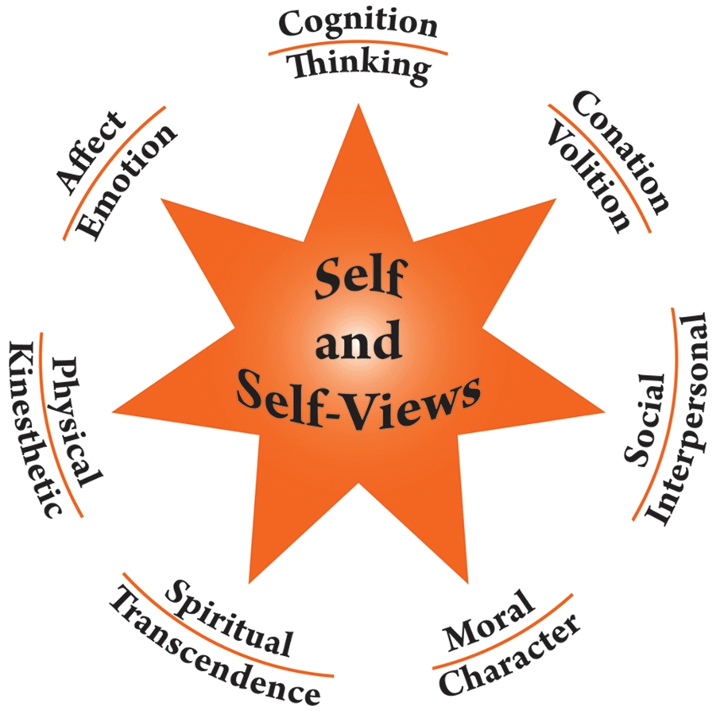
Develop Capacities

Slide 10
Cognitive Intelligence
Most specifically connected to potential for academic achievement
Some believe it is inherently fixed
Others have demonstrated it can be modified
Feuerstein & associates (generic processes)
Instrumental Enrichment
Sternberg & associates (categories)
Analytic
Creative
Practical
Wegner (specific academically-related processes)
22 specific cognitive processing skills

Slide 11
Habits of Mind Costa & Kallik
16 specific patterns or habits
6 habits -- Cognition/Thinking
3 habits -- Affect/Emotion
4 habits -- Conation/Volition
2 habits -- Social/Interpersonal
1 habit -- Multiple

Slide 12
Habits of Mind Costa & Kallik
Cognition/Thinking
Gather data through the senses
Strive for accuracy
Question and pose problems
Apply past knowledge to new situations
Think flexibly
Create, imagine, and innovate

Slide 13
Habits of Mind Costa & Kallik
Affect/Emotion
Listen with understanding and empathy
Respond with wonderment and awe
Find humor
Conation/Volition
Manage impulsivity
Persist
Take responsible risks
Remain open to continuous learning

Slide 14
Habits of Mind Costa & Kallik
Social
Think and communicate with clarity and precision
Think interdependently
Multiple
Metacognition – thinking about one’s own thinking, feeling, intending, strategy development, and behavior and how these affect others

Slide 15
What to Do
Use Senge’s work on Learning Organizations and Losada’s work on high functioning teams
Four primary options for schooling
Academic focus
Huitt, W., Huitt, M., Monetti, D., & Hummel, J. (2009). A systems-based synthesis of research related to improving students' academic performance.

Slide 16
What to Do
Use Senge’s work on Learning Organizations and Losada’s work on high functioning teams
Four primary options for schooling
Academic plus
Academics
Cognitive processing
Wegner – elementary
Feuerstein – middle school
Sternberg – high school

Slide 17
What to Do
Use Senge’s work on Learning Organizations and Losada’s work on high functioning teams
Four primary options for schooling
Partial holistic
Academics
Cognitive processing
Habits of mind
Moral character
Social Emotional Learning

Slide 18
What to Do
Use Senge’s work on Learning Organizations and Losada’s work on high functioning teams
Four primary options for schooling
Holistic
Reggio Emilia
Waldorf
International Primary Curriculum
International Baccalaureate
External & Internal Asset Development

Slide 19
Conclusions
Schools need to provide leadership in developing the whole person
Even those with an academic focus need to connect with other social institutions
Encourage others to participate in addressing other domains
Provide options for school and program choice
Every school required to develop a vision and mission statement (philosophy)
Demonstrate how learning theories, curriculum, instructional practices, and assessments directly support those statements

Slide 20
The End

